Slide 1

WELCOME
Intelligent Course Scheduler

Slide 2
Project Introduction
Intelligent Course Scheduler
A web apps that offers interactive degree planning and personalised course discovery to make picking courses simple and enjoyable for students.

Slide 3
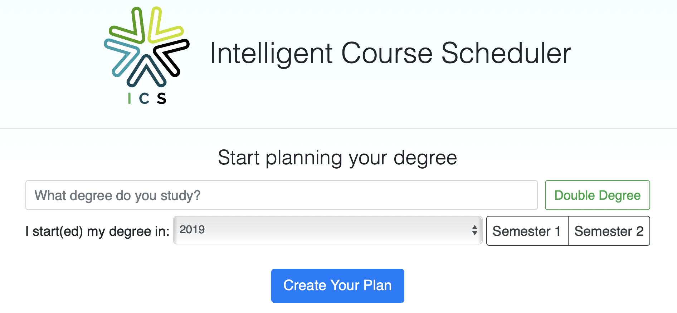
Project Introduction
Intelligent Course Scheduler
A web apps that offers interactive degree planning and personalised course discovery to make picking courses simple and enjoyable for students.

Slide 4
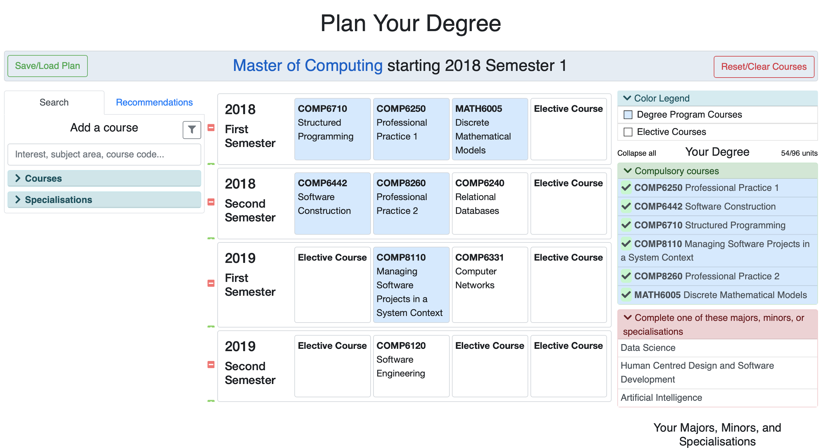
Project Introduction
Intelligent Course Scheduler
A web apps that offers interactive degree planning and personalised course discovery to make picking courses simple and enjoyable for students.

Slide 5
Project Introduction
Intelligent Course Scheduler
This project will enhance the former Intelligent Course Scheduler in the Customisation Interface area (for ANU Staff to maintain the data)
CRUD for courses, degrees, MMS, etc
Duplicate feature
Access Control so specific staff can only maintain specific data

Slide 6
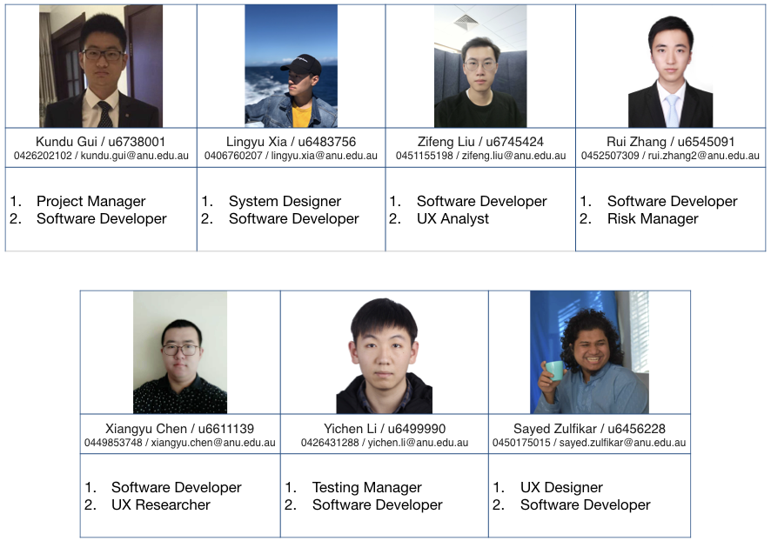
Team Members We are a newly formed project team
Intelligent Course Scheduler

Slide 7

Main Stakeholders
Intelligent Course Scheduler
Our Key Stakeholders
ANU Student Service Staff as the user for the system management.
ANU Students as the user of the system.
Joseph and Safeer as the client.

Slide 8
Client’
Expectations
Intelligent Course Scheduler
Regular and timely communication.
Strong team motivation, teamwork and self-direction.
Critical thinking about project design and direction.
Delivery of a fully-featured and robust product.
Responsibility for maintenance of the live product.

Slide 9
Client's Vision
Intelligent Course Scheduler
Improving the recommendation algorithms
Dynamically auto-generated degree plans for students
More useful information about courses (like reviews)
Providing enrolment metrics to ANU staff
Streamline administration tasks like graduation and timetabling
Improved plan saving and sharing system

Slide 10
Project Impact
Intelligent Course Scheduler
Students will be able to experience a better user interface which will make their course selection clear and efficient.
For some specific majors, some bugs occur when students select course and this website can not be used normally on the mobile services.
We believe that this project will encourage students to explore more about courses and enable students to consider a greater number of options when enrolling.

Slide 11
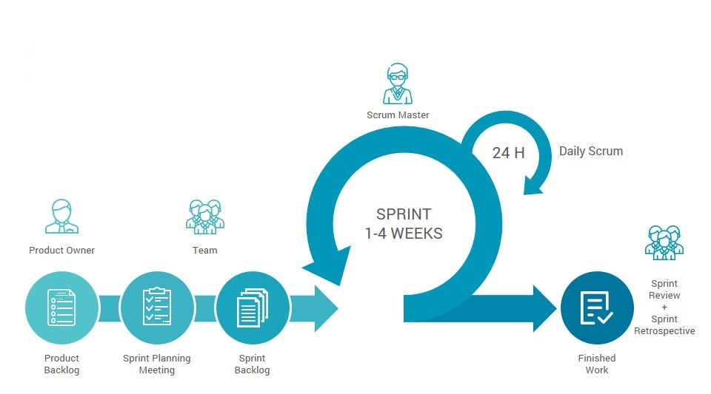
Management Scrum
Intelligent Course Scheduler
Retrieved from: https://www.verbindungszentrum.com/scrum-en/

Slide 12
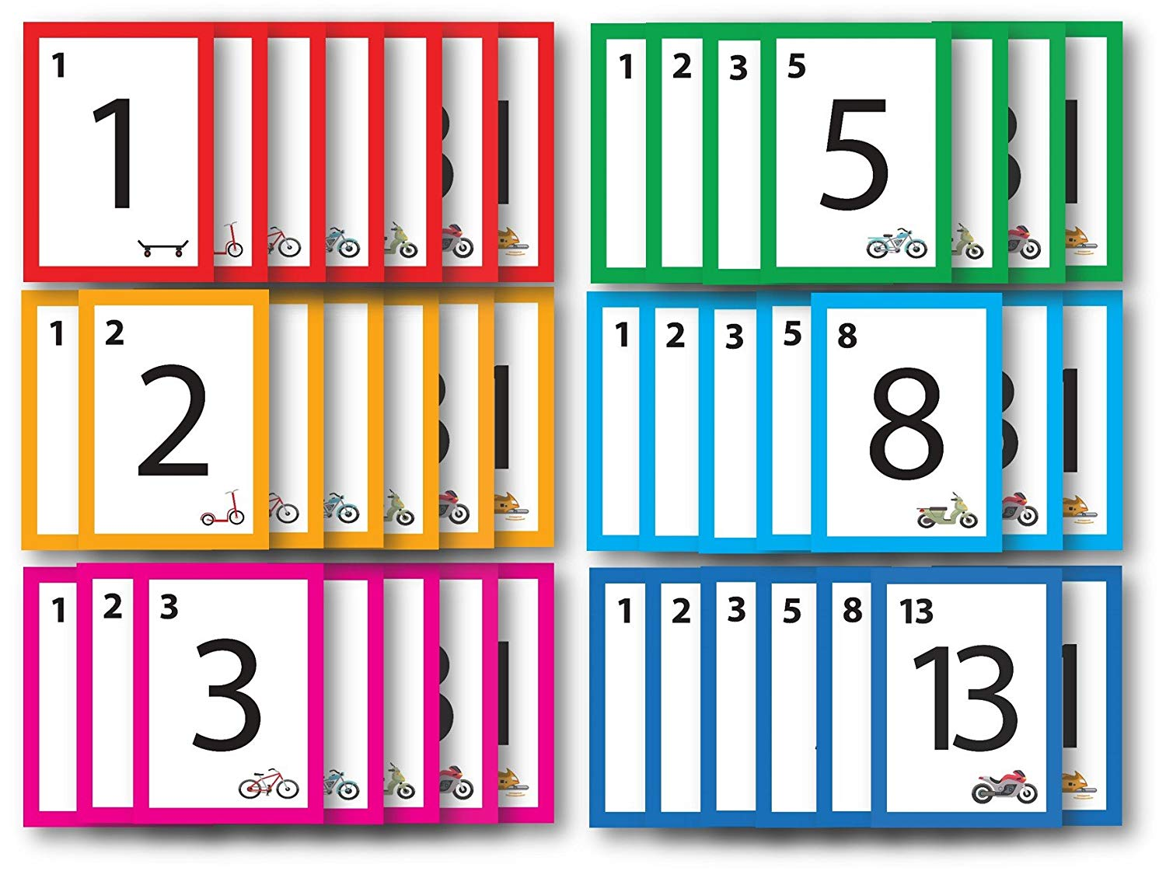
Management Planning poker
Intelligent Course Scheduler
Retrieved from: https://www.amazon.co.jp/Agile-Stationery-Estimation-Poker-Cards-–-Fibonacciシリーズ-–-6セット/dp/B01MDTJDST

Slide 13
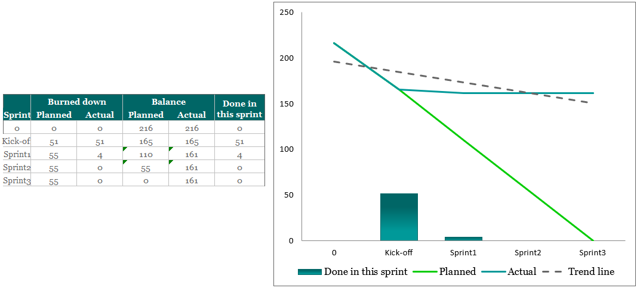
Management
Intelligent Course Scheduler
Brun down chart

Slide 14
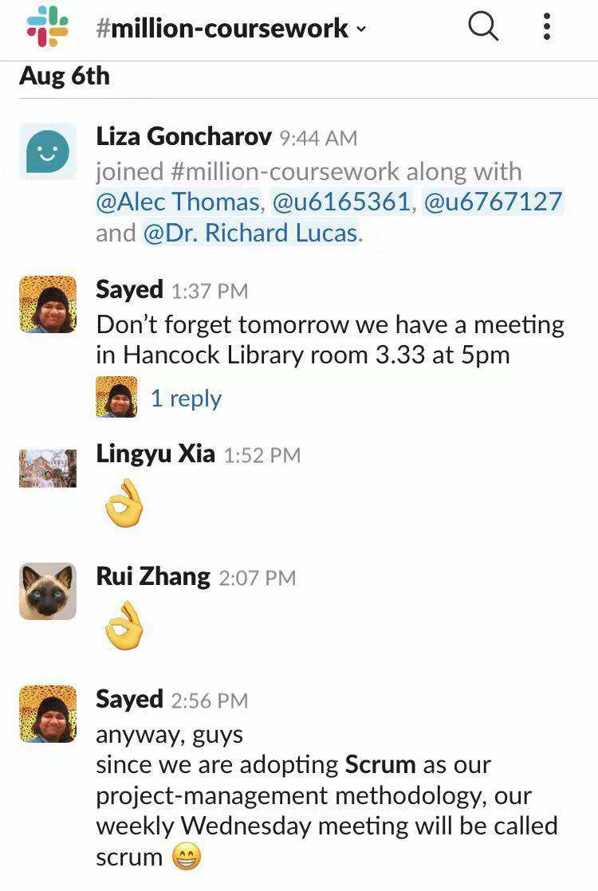
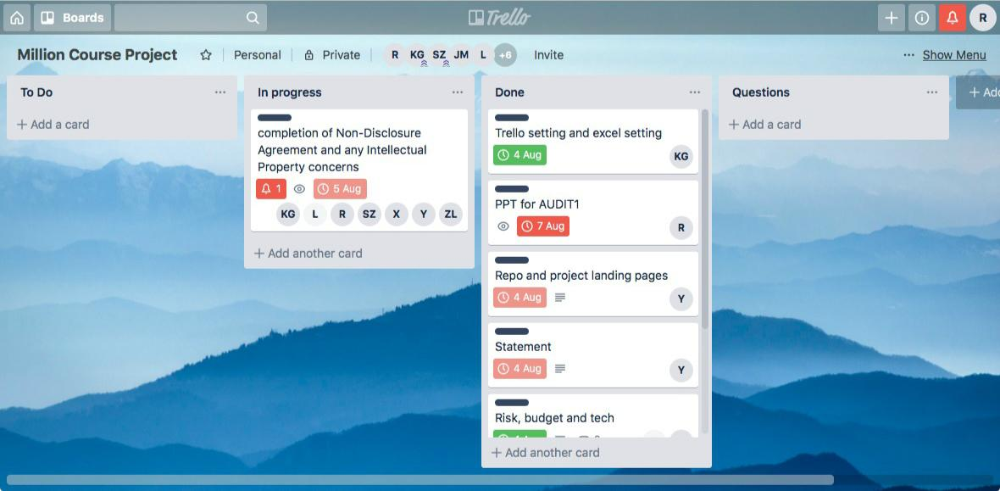


Management Trello & Slack
Intelligent Course Scheduler
Retrieved from: https://worldvectorlogo.com/zh/logo/slack-new-logo
Retrieved from: https://worldvectorlogo.com/zh/logo/trello

Slide 15
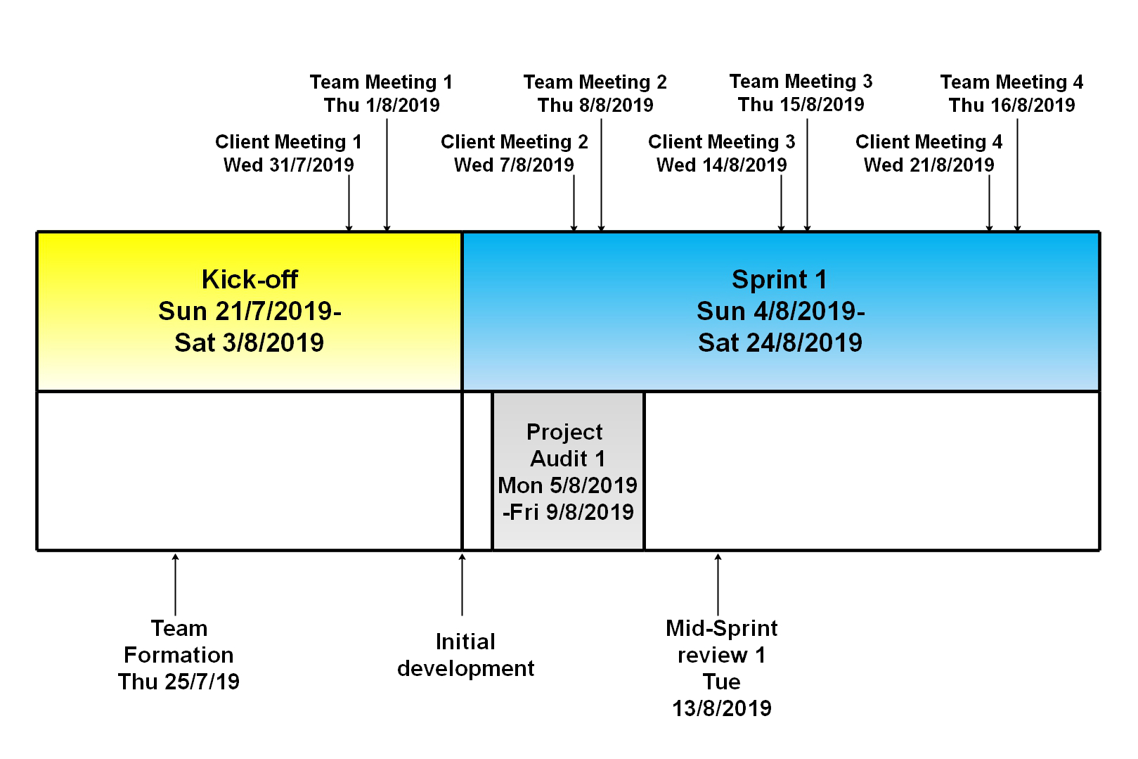
Project Schedule Kick-Off: Weeks 1 - 2. Sprint 1: Weeks 3 - 5.
Intelligent Course Scheduler
Kick-Off: Team member recruitment, onboarding, project definition and setup.
Sprint 1: Project Audit 1, read and update feature for customisation interface.

Slide 16
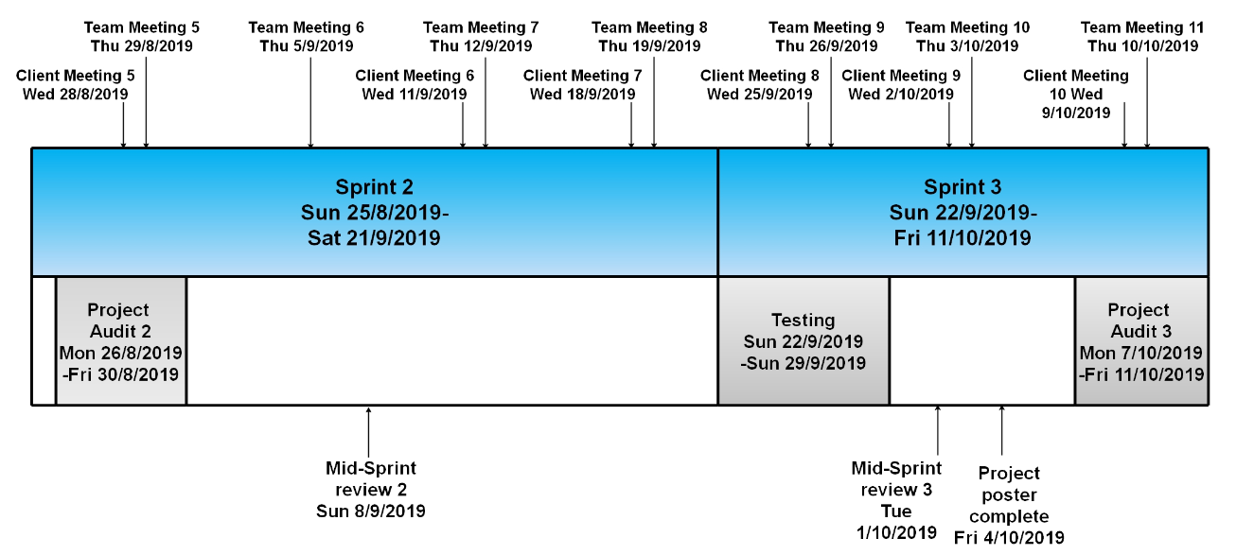
Project Schedule Sprint 2: Weeks 6 - 7. Sprint 3: Weeks 8 - 10.
Intelligent Course Scheduler
Sprint 2: Project Audit 2, create and delete feature for customisation interface, access control.
Sprint 3: Project Audit 3, duplicate feature and project poster.

Slide 17
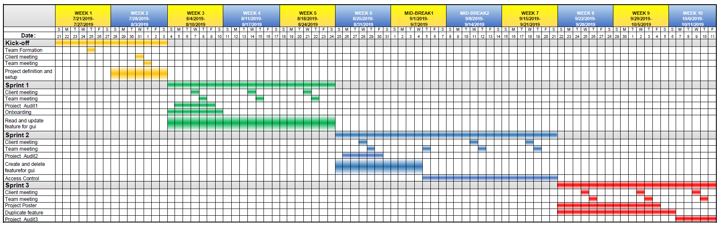
Intelligent Course Scheduler
Project Gantt

Slide 18
Milestones
Intelligent Course Scheduler
Customisation Interface will allow ANU staffs to login into the website and modify the data (Major, Minor, Specialisation). This feature includes the graphical user interface and database operations
Customisation Interface | CRUD | Create, read, update, and delete (CRUD) are the four basic functions for the customisation interface.
 | Duplicate feature | Duplicate function is advanced function for the customisation interface.
 | Access control | Access control allow specific user maintain specific data only.

Slide 19

Technical and Other Constraints
Intelligent Course Scheduler
Database Update
New team on
continuing project
Access Control

Slide 20
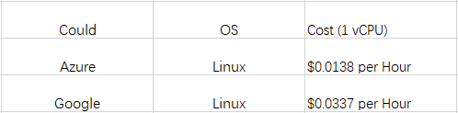
Resources, Risks and potential Costs
Intelligent Course Scheduler
There are always uncontrollable factors in our work.
We should guarantee the highest quality of our product in the shortest time.
Relationship between teammates is also a kind of risks.
Studying new things would take us some time.
Budget for the
Cloud Server:

Slide 21
IP Concerns
Intelligent Course Scheduler
There will be no non-disclosure agreement required.
Any materials, tools, methods/techniques and software provided by Clients advised and agreed to be Clients’ Copyright, will remain the intellectual property of Clients.
New codes developed by project members will be owned by project team.

Slide 22
THANK YOU
Intelligent Course Scheduler
References
Galitz, W. O., & Safari Books Online. (2007). The essential guide to user interface design: An introduction to GUI design principles and techniques (3rd ed.). Indianapolis, IN: Wiley Pub.
SFIA Foundation (2017). Levels of responsibility. Retrieved from https://www.sfia-online.org/en/framework/sfia-7/busskills

